Slide 1

ODBC2KML Project Demo
PolyTech Industries, Inc.
April 13, 2010

Slide 2
Project working structure
Two weekly group meetings
Weekly reports are submitted explaining the progress made on that week
Used to keep track of project schedule and time management
Log is maintained for every activity in the group
Each person is assigned equal amount of work

Slide 3
Impacts of this course
Every document goes through multiple revisions
Make students to understand whole SE process
Builds a good working team relationship
ODBC to KML project makes them to think and work on certain things that they have not covered in courses
Gives them a kind of real world development experience
Really fun experience for all

Slide 4
The Team

Slide 5
The Hours

Slide 6
Major Functions
Create Connection
Edit Connection
Delete Connection
Generate KML File
Web Service
Web Application
Preview KML on Google Maps

Slide 7
List of Requirements
Create Connection
Edit Connection
Delete Connection
View Connection
Map database fields to KML fields
View Values from Database Tables
Set Description
Insert field value into KML description

Slide 8
Requirements, cont.
Upload an Icon from User’s Computer
Upload an Icon from the web
Add an Icon to the Connection
Select Icon Overlay Color
Set Icon Condition
Generate KML from Web Service
Generate KML from Web Application
Preview KML on Google Maps

Slide 9
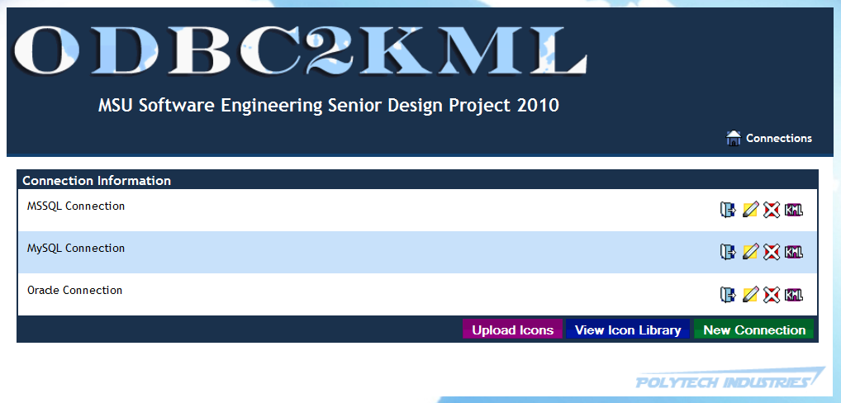
Design – Main Page

Slide 10
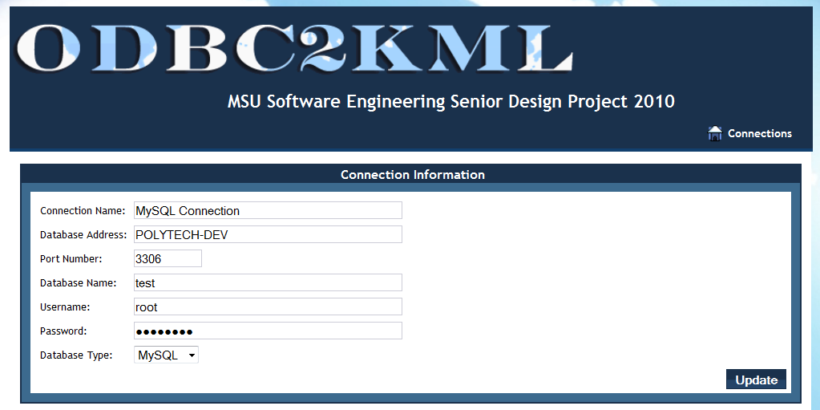
Design – ConnDetails: ConnInfo

Slide 11
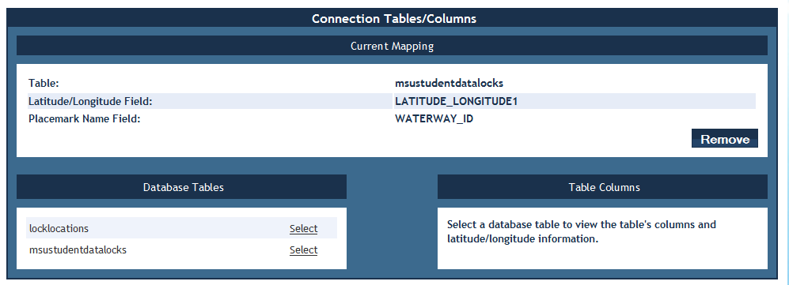
Design – ConnDetails: Mapping

Slide 12
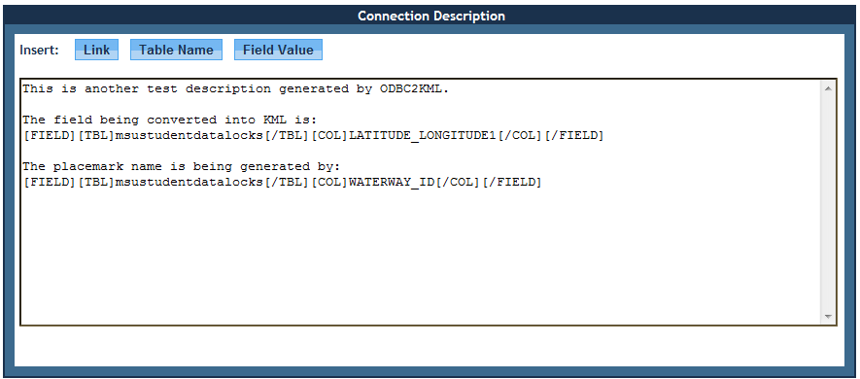
Design - ConnDetails: Description

Slide 13
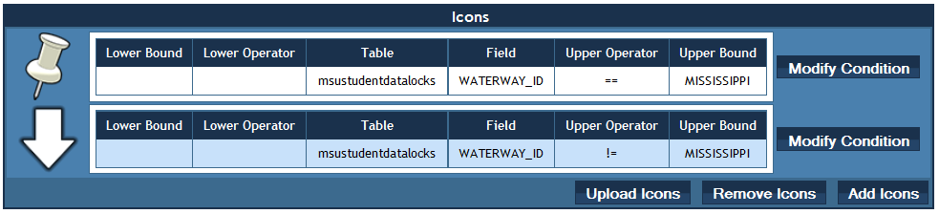
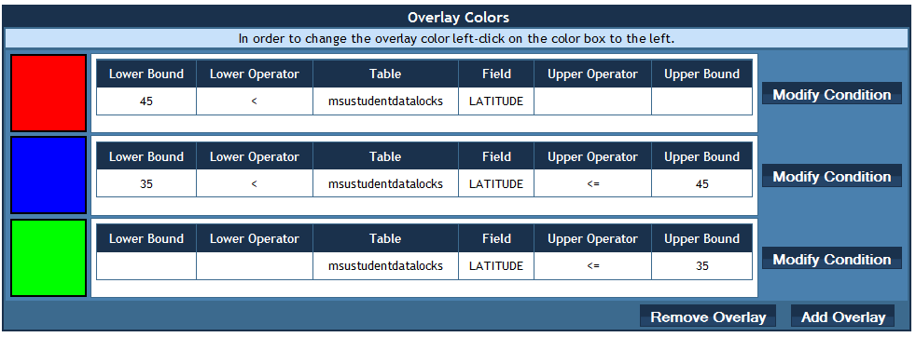
Design – ConnDetails: Icons and Overlays

Slide 14
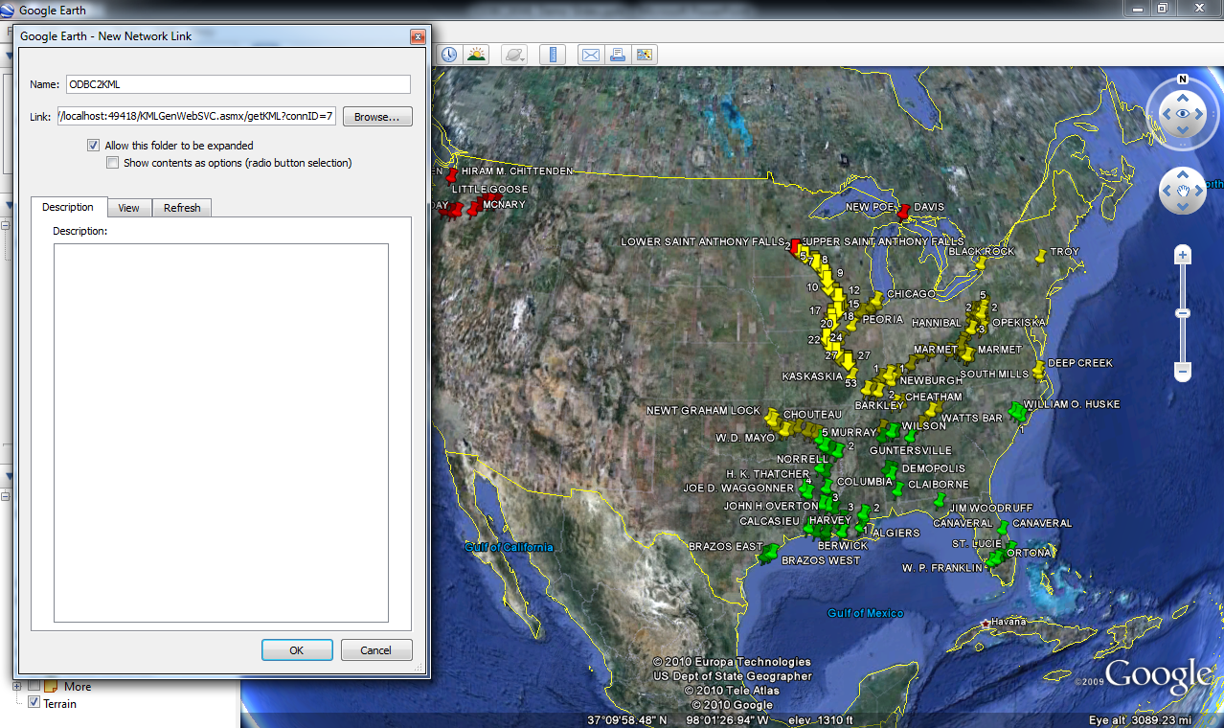
Design - KMLGenWebSVC

Slide 15
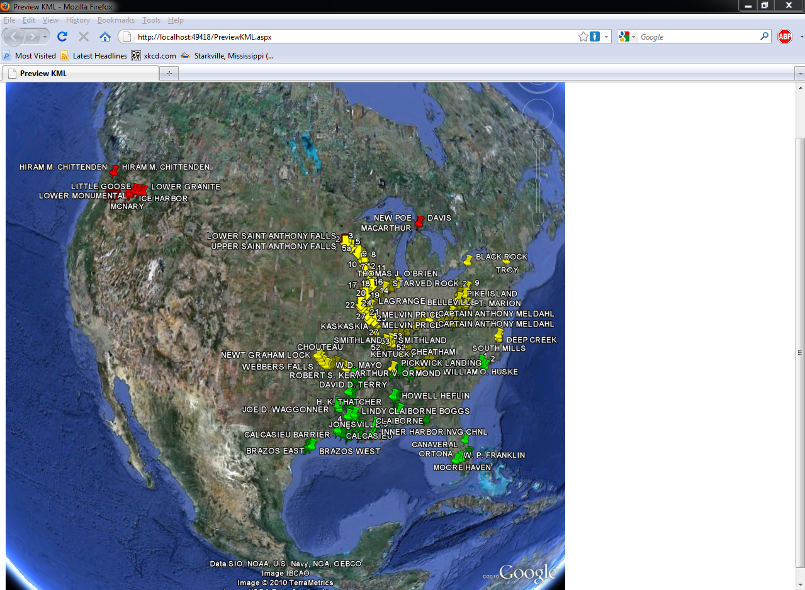
Design – Preview KML

Slide 16
Demo Hardware Setup
ODBC2KML in VM
Client Laptop
Remote Data Source in VM

Slide 17
Questions?

